Slide 1

Wastewater Rate Study
Hilton Creek Community Services District
Robert D. Niehaus, Inc.
June 7, 2023

Slide 2
Agenda
Talk about why rate increases are needed
Show finances under current revenues and proposed revenues
Explain cost of service analysis
Show proposed rates
Show rate impacts

Slide 3
Why are rate increases needed?
Rising operating costs
Capital needs
Regulatory concerns
Additional qualified staff
Emergency reserves
Last rate study more than 20+ years ago!

Slide 4
Financial Plan

Slide 5
Current Rates (revenue)

Slide 6
Billing Unit Growth (revenue)
Notes:
39 new billing units this year. Projecting no growth otherwise

Slide 7
Financial Plan (expense drivers)
Needed Capital Expenditures:
Sludge dewatering
Emergency generator plant
Aeration blowers
Reserve Targets:
3 months of operating (for emergencies)

Slide 8
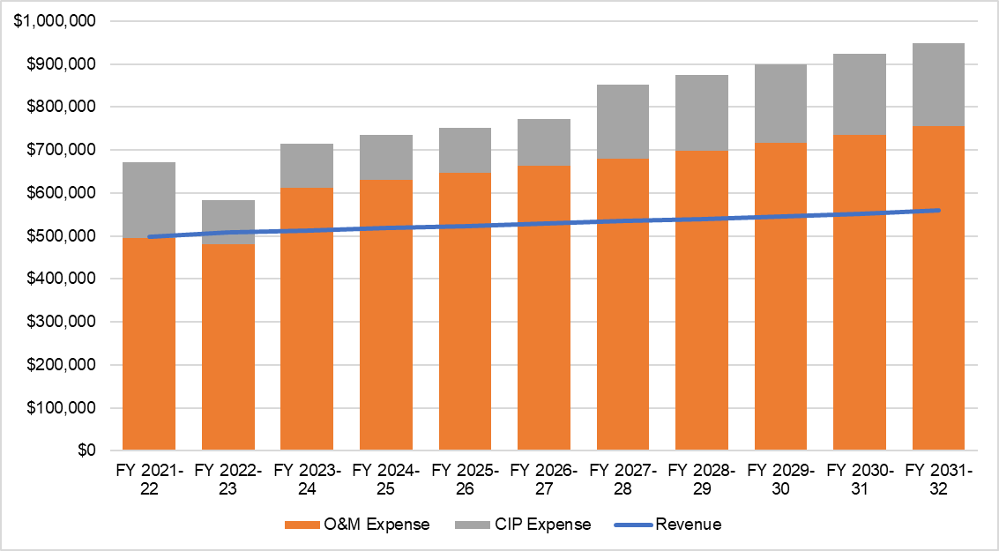
Financial Plan (no increase)

Slide 9
Cash Flow (no increase)

Slide 10
Revenue Adjustments
Initial increases offset the need for future rate increases, overall increases are lower
Initial increases solve cashflow issues

Slide 11
Revenue Requirements

Slide 12
Cost of Service

Slide 13
Cost of Service Analysis
Mass Balance Analysis – Determine the relative strength and flow of customer classes (COS Units)
No water use data
Total flow ~26.7 MGY
EPA averages for flow and strength

Slide 14
Cost of Service Analysis

Slide 15
Cost of Service Analysis

Slide 16
Cost of Service Analysis Allocation

Slide 17
Cost of Service Analysis

Slide 18
Proposed Rates

Slide 19
Rate Recommendations

Slide 20
5-year Rate Plan

Slide 21
Rate Impacts

Slide 22
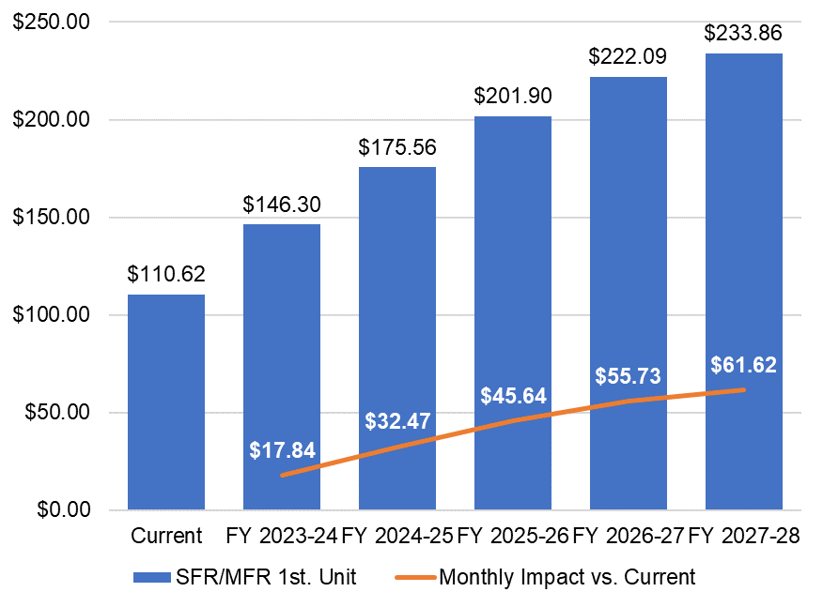
Rate Impacts
Initial residential impact ~ $17.84 per month
Commercial impacts vary by fixture

Slide 23
Questions?

